Slide 1
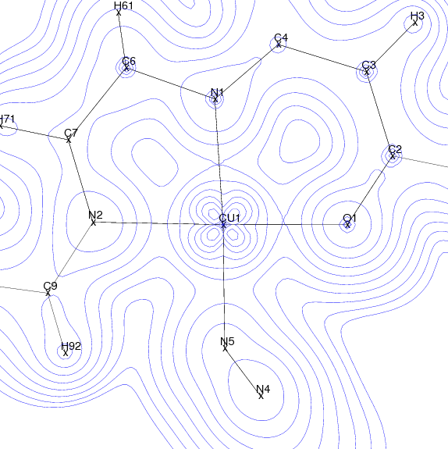
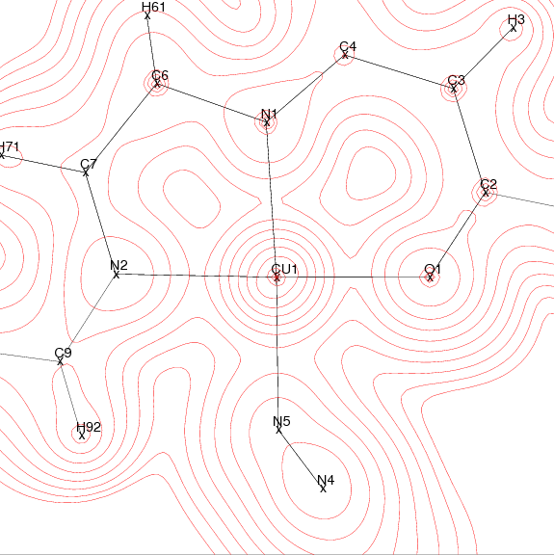
Xrays and neutron joint refinement
Claude Lecomte, Maxime Deutsch, Bolivar Voufack ,
Mohamed Souhassou , Nicolas Claiser
,Beatrice Gillon, Jean Michel Gillet
CRM2 Univ Lorraine , Lab Leon Brillouin, ECP Paris

Slide 2
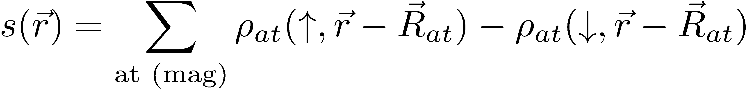
Charge and Spin densities
We are able to model the electron density
and therefore all derived properties (MOPRO , XD )
A step further :
modeling the magnetic properties
Polarized Neutron diffraction gives
the spin density which is
Proportional to the magnetic moment

Slide 3
Joint refinements ? A very long story !
X ray and neutrons
J. A. K. Duckworth, B.T.M. Willis and G. S. Pawley, Acta Cryst. (1969). A25, 482
P. Coppens, R. Boehme, P. F. Price and E. D. Stevens, Acta Cryst. (1981). A37, 857
A. Wlodawer and W.A. Hendrickson, Acta Cryst. (1982). A38, 239-247
P.D. Adams, M. Mustyakimov, P.V. Afonine and P. Langan, Acta Cryst. (2009). D65, 567–573
Spin and charge densities
P. Becker and P. Coppens. Acta Cryst. (1985). A41, 177-182
P. Coppens and P. Becker, Int Tables for Cryst, Vol C, 1995 ,627 Analysis of charge and spin densities
Notes:
Proposing joint refinements is not a new idea. Since years, people proposed to refine jointly different quantities
In 1969, Duckworth and coworkers proposed to jointly refine X ray and neutron diffraction data. This idea reappears periodically with at each time some new progress and new difficulties
The history is more recent concerning the joint refinement of spin and charge densities but follow the same evolution with periodical progress

Slide 4
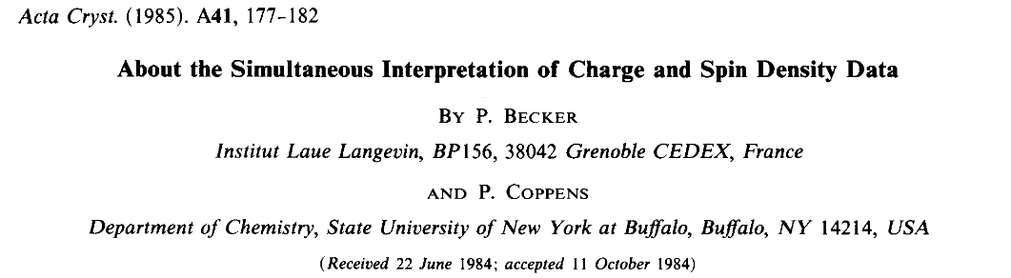
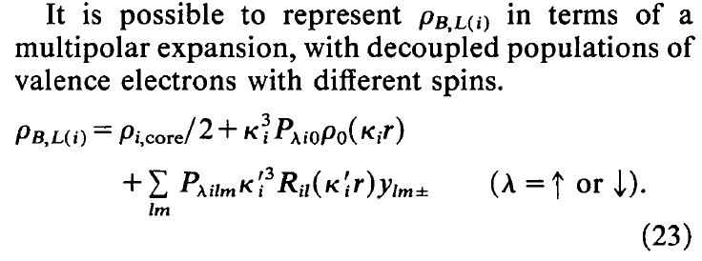
A very long story 30years

Slide 5
OUTLINE
Neutron and polarized neutron diffraction
The charge spin multipole model et MollynX
Test : a Cu – Mn molecular crystal
First spin resolved charge density maps:
an azido di copper complex
Preliminary results on an organic radical

Slide 6
Neutron Properties
Mass =1.675 .10⁻²⁷kg Life time = 887s Charge 0
Magnetic moment =- 1.913 μn Spin = ½
Highly penetrating and non destructive
Sensitive to magnetic structure and magnetic fluctuations
It has particle and wave properties
λ= 9.04 √ E
Energy ( meV) Temp (K) Lambda (Ǻ
Cold 0.1 – 10 1 – 120 30 –4
Thermal 10 – 100 120 -1000 4 – 1
Hot 100- 500 1000- 6000 1 – 0.04
Boltzman distribution of energies
E = mv² / 2 = k_{B}T much less than Xrays ( hν)

Slide 7
Neutron diffraction
Coherent Nuclear Scattering
Neutrons are scattered by nuclei which appear as point scatterers ; therefore the
form factor or scattering factor b is a constant versus sinθ/λ.
b is isotope dependant and its value does not follow the periodic table
contrary to the Xrays scattering factor f (sinθ/λ) .
For a given nucleus b depends on the nucleus spin state I ;
The coherent scattering amplitude for C, V , ⁶²Cu , ⁵⁵Mn are respectively
6 , ₋0.5, 7.6 -3.9 fm ( 10 ⁻¹⁵ m )
In some cases incoherent scattering may be large ( H atoms ) and the corresponding
scattering section is σ _{incoh} = σ_{total} - σ _{coh}= 4 π( <b²> - <b>²)
with σ_{total} = 4 π <b²>
As for Xrays we can define a structure factor F_{N} (H)

Slide 8
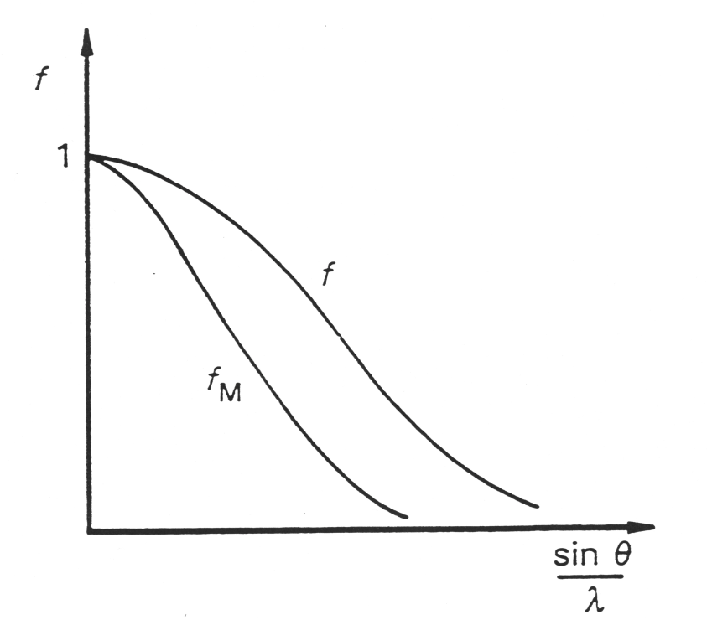
Utmost property of the neutron diffraction
Magnetic structure factor
F_{M}(H) = b_{Mj}(H)⋅exp[2πi(H·r_{j})]·T_{j}(H)
With b_{M} magnetic scattering amplitude
b_{Mj}(H) = (e²γ/2m_{e}c²)⋅f_{Mj}(H)⋅σ⋅m_{⊥j}(H)
• neutron spin operator ½ σ
• m_{⊥j}(H) is the projection of the magnetic moment m_{j}
onto the scattering plane (hkl)
• magnetic form factor f_{Mj}(H): Fourier transform of the normalised magnetization density M_{j}(r) of the atom j
f_{Mj}(H) = ∫_{V} M_{j}(r)·exp[2πi(H·r)]·dr
radial Fourier transform of the ‘magnetic’ electrons
Density with f_{Mj}(0) = ∫_{V} M_{j}(r)·dr = 1 ‘

Slide 9
Neutron diffraction: Some Important features
 Bragg intensity of magnetic and nuclear neutron scattering are of the same order of magnitude.
 For unpolarised neutrons:
incoherent superposition of magnetic and nuclear contributions
I(H) = I_{N}(H) + I_{M}(H) ∼ |F_{N}(H)|² + |F_{M}(H)|²
 For polarised neutrons:
coherent superposition of magnetic and nuclear contributions
[|F(H)|²]± = |F_{N}(H) ± F_{M}(H)|²
with the interference terms ± 2⋅ |F_{N}(H)⋅ F_{M}(H)| according to the two possible directions of polarisation (+ and −).

Slide 10
Special interest of neutron diffraction
✓ accurate localisation and thermal parameters of light elements
hydrogen atom , lithium ( Li NbO3)
✓ distinction of neighboured elements
e.g. 3d transition metals such as Cr – Mn – Fe or Mg²⁺ - Al³⁺ - Si⁴⁺
(important for materials and for minerals )
✓ distinction of different isotopes of one element
the proton/deuteron case ( negative/positive b)
✓ accurate and detailed atomic distributions in complementarity with Xrays
dynamic and static mean square displacements, atomic and molecular disorder, harmonic and anharmonic potentials
✓ standard method for magnetic structure determination
all types of ferromagnets, antiferromagnets, ferrimagnets as well as non-collinear and helical spin ordering
✓ spin density determination by polarised neutron diffraction
molecular magnetic compounds, materials, radicals
joint charge and spin density refinement ( Xray + neutron)

Slide 11
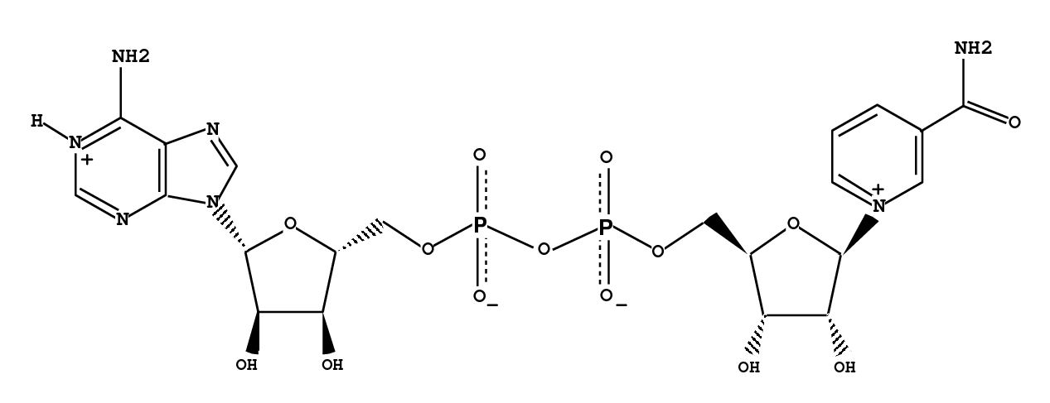
Applications of nuclear neutron diffraction: H Atoms
High resolution neutron structure of
Nicotinamide Adenine Dinucleotide (NAD⁺)
Neutron diffraction data were collected at 100(2)K at the Léon-Brillouin Laboratory . Because of the relatively small size of the crystal( 5.5 x 1.4 x 1.3 mm³ ), 20 days of exposure were necessary to collect half a sphere of data.
Wavelength (Å) 0.8305(2)
Space group, Z: triclinic P1 ,1
Unit cell a, b, c (Å) 8.57(1), 8.83(1), 11.19(1)
α, β, γ (°) 109.7(1), 90.6(1), 104.0(1)
Resolution (Å) 0.65 (-13 ≤ h ≤ 13, -13 ≤ k ≤ 13, -17 ≤ l ≤ 1 )
Nb. measured ; unique reflections: 6343 ; 5990
Nb. reflections with Ι /σ_{I} > 3 4988
R_{merge}(I) : 0.056
Reflections with Ι >3σ_{I} 78 %
All reflections Ι /σ_{I} > 3
R (F) 0.095 0.062
wR (F) .054 0.050
g.o.f, 1.95 2.00
B. Guillot et Al , Acta Cryst., 2001, D57, 981-989 and J. Phys. Chem. B, 2003, 107, 9109-9121

Slide 12
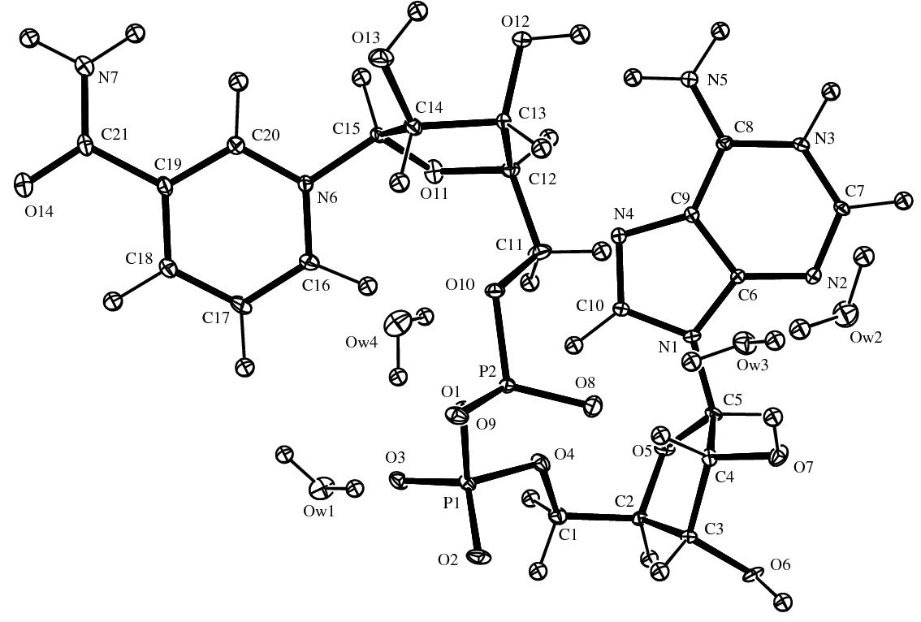
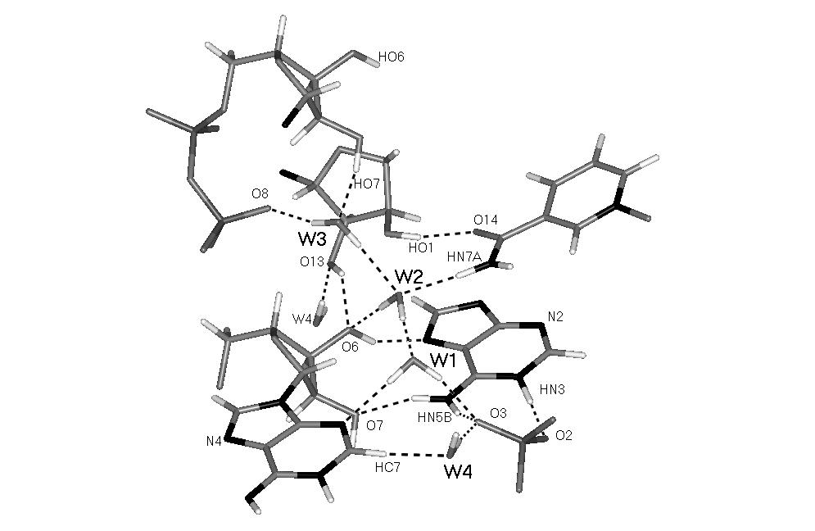
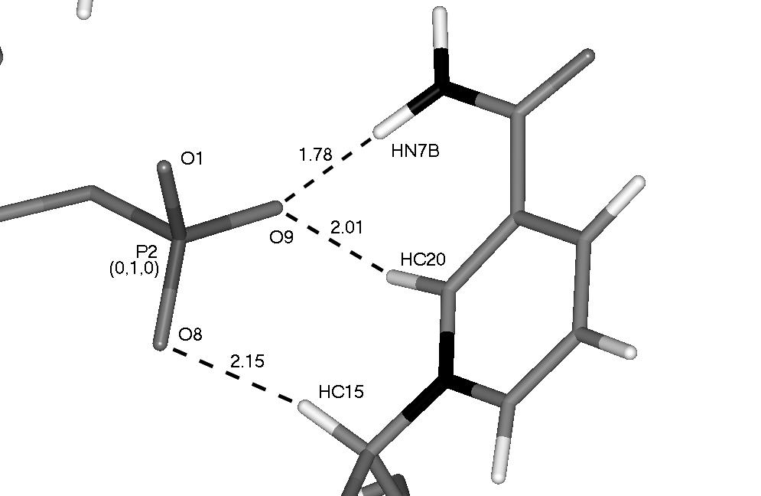
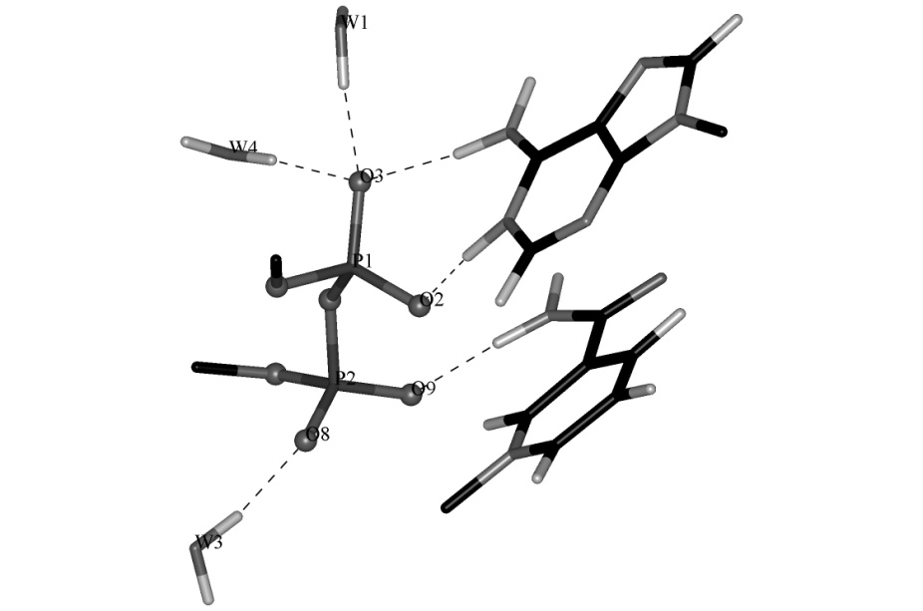
Crystal structure of NAD+ by neutron diffraction
Hydrogen bonding pattern around the water molecules
. Intermolecular hydrogen bonds between the nicotinamide nucleoside and the pyrophosphate moiety.
B. Guillot et Al , Acta Cryst., 2001, D57, 981-989

Slide 13
Comparison of Isotropic thermal displacement parameters
. The equivalent thermal factors U_{eq}(X-ray) and U_{eq}(neutron) of the non hydrogen atoms
are proportional with a ratio of 1.16(7)
However even with this correction there was a bad agreement
between the direction of some ellipsoids

Slide 14
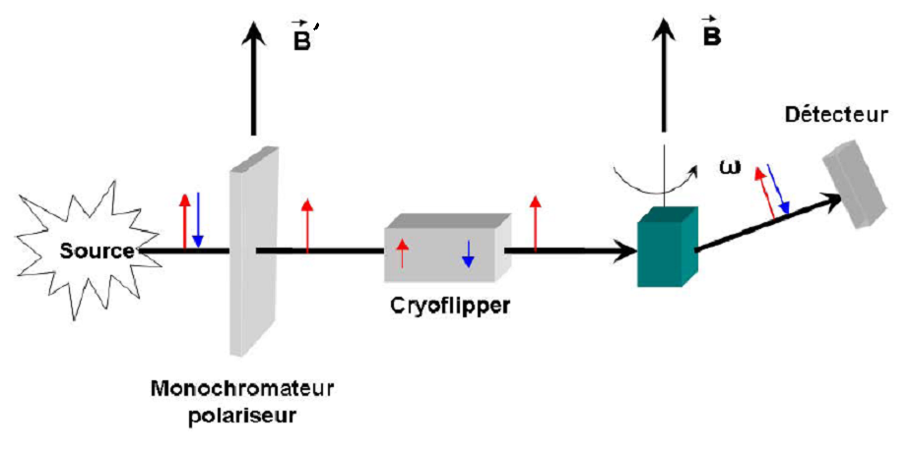
Polarized neutron diffraction
+
-
I₊
1+2γ
R=
≈
with γ=F_{M}/F_{N}
I₋
1-2γ
14

Slide 15
Polarising Monochromator
A polarising monochromator is a ferromagnetic crystal characterised
by one Bragg reflection for which |FM|=|FN|
The beam polarisation is defined as the ratio :
p = (n+ - n- ) /(n+ + n-)
where n+ and n- are the probabilities of finding respectively neutrons
with spin parallel (up) or antiparallel (down) to the external magnetic field ;
n+ = n-= 50% for unpolarised neutrons.
The intensity diffracted by the monochromator is proportionnal to
± |FN ± FM|²
The diffraction of the polychromatic neutron beam on this crystal, in the Bragg position
θ = θ_{M}, yields a neutron beam, in the direction 2θ_{M},
with a selected wavelength and a definite spin state
The Heusler monochromator
Cu2MnAl
FM = - FN for the (1 1 1) reflection
then I+ =0 and I- is prop to (2 FN)²
--> only spin down neutrons are diffracted by the mono.
That means that the neutron spin is opposite to the applied magnetic
guide field after diffraction by the Heusler monochromator.

Slide 16
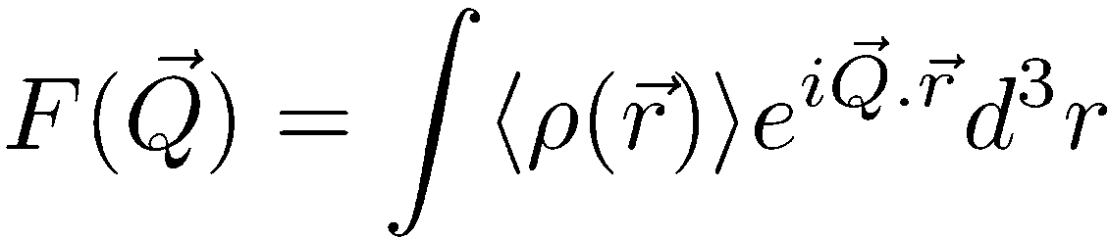
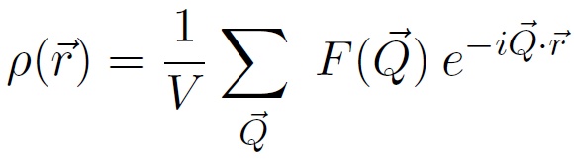
X-ray diffraction
Structure factors
Crystal structure (atomic positions, U_{ij})
Charge density
16
Notes:
A small remind about X-ray (I don’t know if it’s very necessary at the European crystallographic meeting but let’s do it anyway:
If you measure the intensity of diffraction peaks you have access to structure factors, which give you the crystal structure (atomic positions and thermal motion parameters) and the charge density (by Fourier summation).

Slide 17
Unpolarised Neutrons
Unpolarised Neutron Diffraction
Nuclear structure factors
Crystal Structure
(atomic positions, U_{ij}, important for H atoms)
17
Notes:
For neutron diffraction it’s the same story
If you use an unpolarised neutrons beam you have access (in most case) to the nuclear structure factors which give you the structure (atomic positions) and especially the H positions and thermal motion parameters, which are the hardest to see with X-ray.

Slide 18
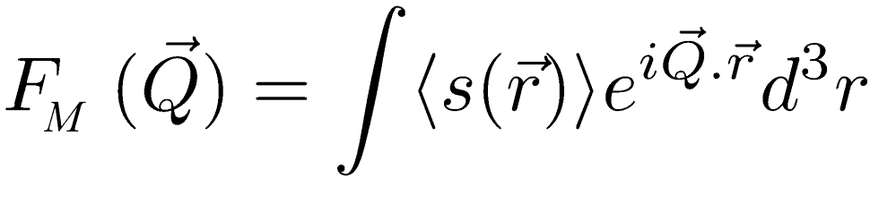
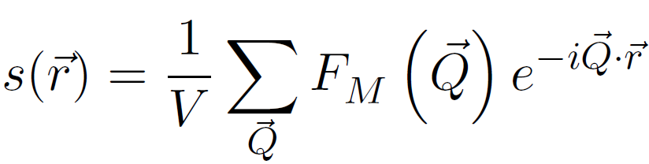
Polarised Neutrons
Polarised Neutron Diffraction gives
the spin density s(r) =
(ρ↑( r)-ρ↓(r)
Flipping ratios or Magnetic structure factors
Spin density = (ρ↑-ρ↓)
18

Slide 19
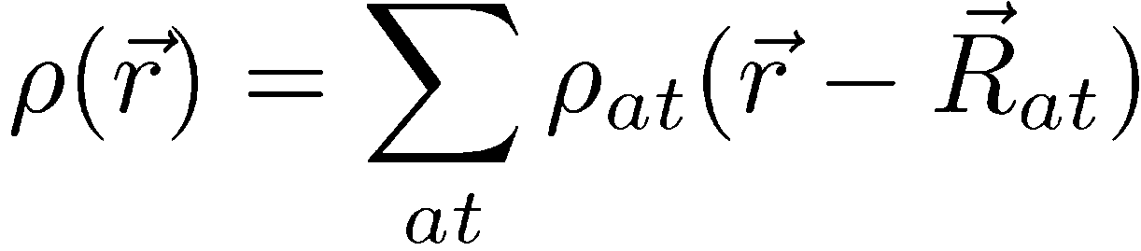
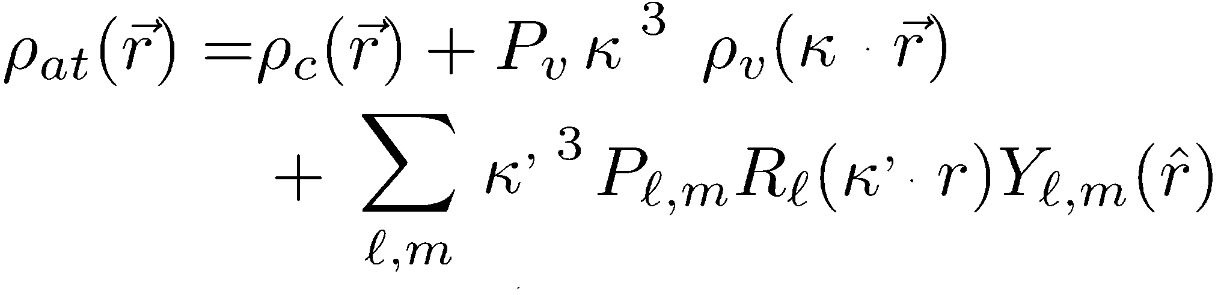
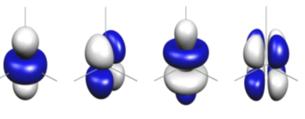
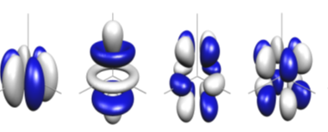
Hansen Coppens Model for charge density
Spherical core
Spherical valence
Aspherical Valence
Y₂₀
Y₂₁
Y₃₀
Y₃₂
Y₃₃
Y₄₀
Y₄₂
Y₄₂
19
* Hansen, N. K. & Coppens, P. (1978), Acta Cryst. A34, 909–921.
Notes:
The first one (ρcore) is the spherical core density, the second one (ρval) is the valence densities. The third term models the aspherical part of the valence density.
The angular functions Ylm are real spherical harmonics and Rl are generally Slater-type functions. Pv and Plm coefficients are, respectively, the valence populations and deformation density multipoles populations. Parameters κ and κ' model the dilatation/contraction of the electron cloud. This model was used first in the MOLLY program and now in more recent program (MoPro, XD for exemple)

Slide 20
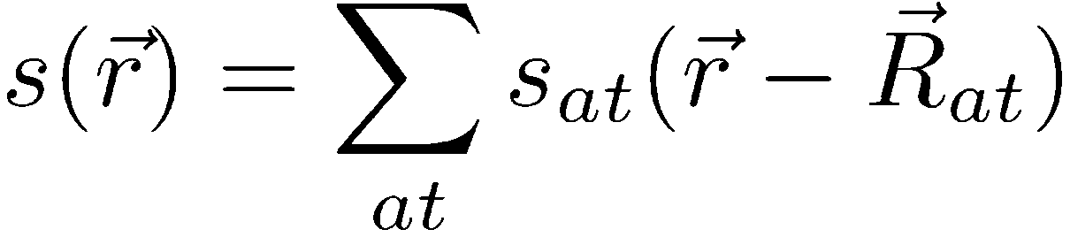
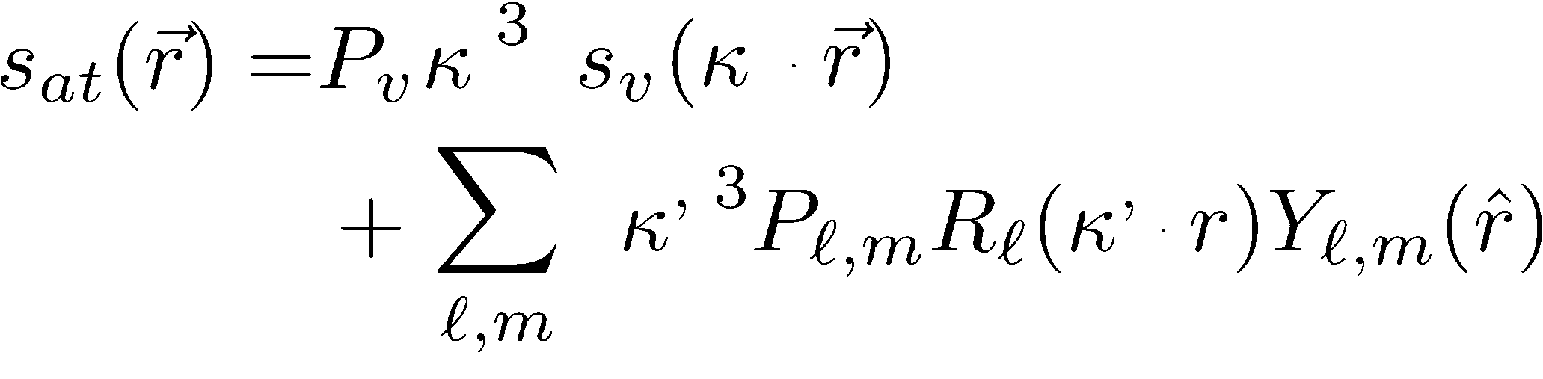
HC Model for spin density
Spherical valence
Aspherical Valence
Y₂₀
Y₂₁
Y₃₀
Y₃₂
Y₃₃
Y₄₀
Y₄₂
Y₄₂
20

Slide 21
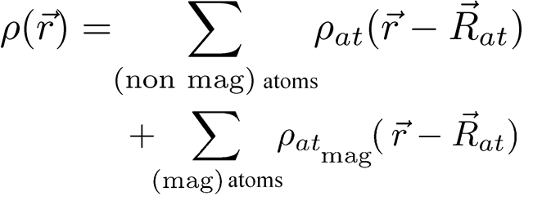
Spin and charge densities: joint model
The « spin split » model*
Split the H&C density model in 2 parts for magnetic atoms:
* Deutsch et al. Acta Cryst, A68 (2012) 675-686 and IUCrJ , may 2014
P. Becker and P. Coppens. Acta Cryst. (1985). A41, 177-182
Notes:
How do we combine charge and spin density?
We simply use the suggestion of Becker and Coppens and build the spin split model in which we use the classical Hansen and Coppens model for non magnetic atoms and we just split the magnetic atom in rho atomic up and rho atomic down.

Slide 22
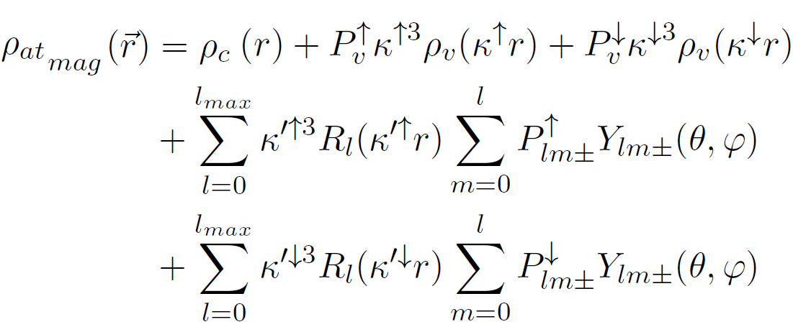
Spin and charge densities: joint model
Spherical core density
Spherical valence density
Non spherical valence density
Programme Mollynx

Slide 23
Methodology
From the observables to the parameterization of the density :
least-squares
X-ray Diffraction ➔ Structure Factors ➔Charge Density
Unpolarised Neutron ➔ Nuclear Structure Factors ➔ Atomic Structure
Polarised Neutron ➔ Magnetic Structure Factors➔ Spin Density
Function to minimize: ?
23
Notes:
Now the model is defined, how do we get the values of parameters?
The separated study procedures consists of a least-square refinement to obtain an experimental values for the parameters
In all cases we calculate the difference between observed and calculated quantities and we try to reduce the resulting chi (pronouced “caille”) parameter.
(In case of the x-ray diffraction, we measure structure factors and we model the charge density by minimising the chi square value.
In case of neutron diffraction, we measure nuclear structure factors and we model the structure by minimising the chi square value
In case of the polarised neutron diffraction, we extract magnetic structure factors from the experimental flipping ratios and we model the spin density by minimising the chi square value.)
But 1 question appears :
For a joint refinement what is the function to consider for the least square refinement ?

Slide 24
Methodology : Weighting schemes
X-Rays: ~10,000 reflections
Neutrons: ~ 1,000 reflections
Polarised Neutrons: ~ 100 reflections
Function to minimize: ?
Unit
NLog
Log
Bell et al., Comp. Stat. And Data Anal., 22, (1996), 119-135
J-M. Gillet et al., Phys. Rev. B, 63, 235115 (2001)
24

Slide 25
Methodology : Assumptions and Constraints
Cell parameters: from RX = N
Positions: RX and N
Thermal parameters: U_{ij-RX} ≠ U_{ij-N}
25
Notes:
To do such a joint refinement, we need to use different assumptions
The cell parameters are identical for Xray and neutron diffraction experiments because Atomic positions are jointly refined on Xray and neutron diffraction data
Atomic displacement parameters are common for both neutron diffraction experiments but different from the one observed for Xray diffraction experiment
As seen before, we refine valence population and multipolar population with spin up and spin down separately and we also refine separately their respective K parameters
We also applied several constraints to our model. And I will give you some details about these constraints in the next slides.

Slide 26
Methodology : Global constraints
Electro-neutrality
Spin population = # of unpaired electrons
26
Notes:
2 global constraints are used:
electroneutrality for the total number of electrons which corresponds to the sum of the splitted and non splitted valence population parameters
and we impose the total spin population that corresponds to the difference of the split valence population parameters to be equal to the number of unpaired electrons which is equal to the magnetic moment observed at saturation (if there is no orbital contribution).

Slide 27
Methodology : Local Constraint
In order to insure |Plm↑ + Plm↓|> |Plm↑ - Plm↓|
The most efficient way :
(Plm↑ - Plm↓)=cos(α)×(Plm↓+Plm↑)
Parameters to refine : α and (Plm↑ + Plm↓)
Instead of Plm ↑ and Plm↓
2nd order derivatives are non zero
non-linear refinement
27
Notes:
This implies to add new constraints in our splitted model
We have to avoid having more unpaired electron than total electron in a multipole
Different attempts were made, the more efficient way we found is to link the both values, the sum of the mutipolar splitted parameter and the difference by a cos alpha parameter
This implies to change refined parameters and induce second derivatives.
Our refinement is no more linear but we avoid the spin population to reach non physical values
We have yet define our joint refinement program, it is time to test it !

Slide 28
The weighting scheme is important for parameters refined on two experimental data sets
 | Scale factor |  |  | Atoms
 | X | N | PN | xyz | U_{ij X} | U_{ij N} |  | κ κ’ | P_{v}↑+P_{v}↓ P_{lm}↑+ P_{lm}↓ | cos(α)
X | X |  |  | X | X |  |  | X | X | X
N |  | X |  | X |  | X
PN |  |  | X |  |  |  |  | X | X | X
(Plm↑ - Plm↓)=cos(α)×(Plm↓+Plm↑)
28
Notes:
The selected weighting scheme will have an influence for parameters refined on two data sets,
At this point, it is important to list the different parameters and the data used for their refinement,
We apply one scale factor for each data set,
Concerning the atoms, their positions are jointly refined on Xray and neutron diffraction data
The K parameters are jointly refined on Xray and polarised neutron diffraction data
This is also the case for the sum and the difference of the spherical valence and the sum and the difference of the multipolar valence and again, the role of the weighting schemes can be crucial it that case

Slide 29
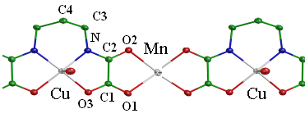
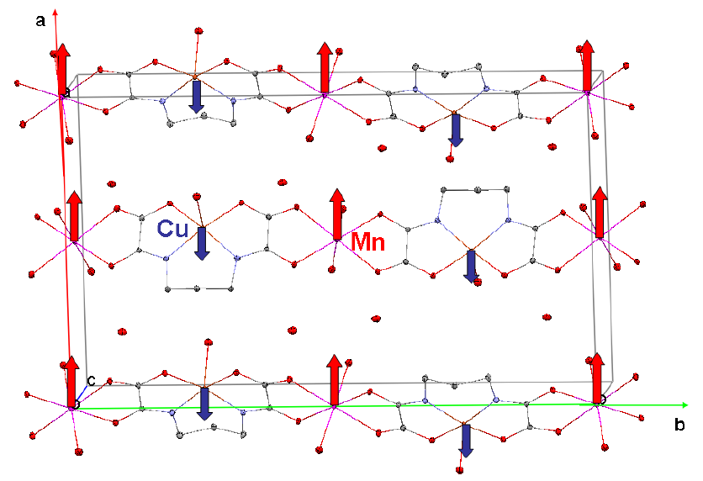
First test : MnCu(pba) bimetallic chain
Pillet et al, (2004), J. Am. Chem. Soc., 126, 1219-1228
Baron et al, (1997), J. Am. Chem. Soc., 119, 3500-3506
Ferrimagnetic Chain
Mn²⁺ & Cu²⁺ ions alternate
pba = 1,3-propylenbis(oxamato)
29
Notes:
Our spin split model is yet ready for tests
We decided to test it on a molecular magnetic complex : the MnCu(Pba) bimetallic chain
This complex has already been studied by Sébastien Pillet for the total charge density and by Valery Baron for the experimental spin density,
It consist of Mn and Cu atoms alternating along an organic chain, the Mn and Cu magnetic moments are opposed and the chain is ferrimagnetic

Slide 30
Test compound: experimental data
Xrays and PN , no Neutron data
a,b,c (Å) 12.7858(5), 21.2972(8), 5.1864(2) Space group Pnma
 | X-rays | Polarised neutrons
Number of reflections | 6880 | 228
Temperature (K) | 10 | 10
Magnetic Field (KOe) | - | 50
Wavelength (Å) Resolution (Å⁻¹) | 0.71073 0.98 | 0.83 0.49
30
Notes:
We present here some characteristics of the different data collections,
One can notice that the data collection temperatures were the same (10K) for the two experiments.
We notice also that the experimental resolution reached by Xrays is twice the one observed for polarised neutrons
As mentioned before, the large difference in terms of data set sizes here obvious: we have 30 times more X-ray data than polarised neutron data.

Slide 31
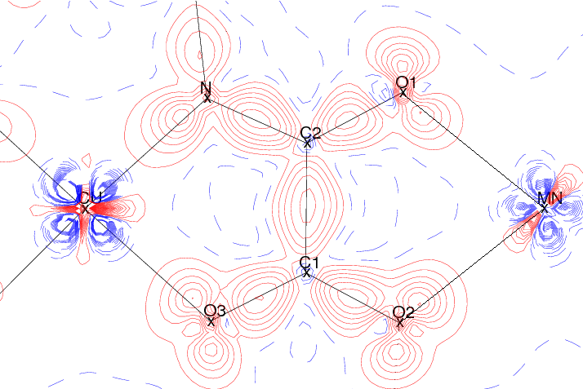
Joint refinement does not degrade the quality of the charge density maps
X-rays only
Joint refinement
(charge and spin) Log
Charge
Static deformation charge density map
Contours 0.1e⁻.Å⁻³ ,
positive red, negative blue
Static deformation charge density map
Contours 0.1e⁻.Å⁻³,
positive red, negative blue
R_{w}(F) G.o.F N_{obs} N_{par}
0.0161 1,55 6880 413
R_{w}(F) G.o.F N_{obs}^{X} N_{par}^{X}
0.0164 1.58 6880 413
31
Notes:
I am showing you the results we obtained for this joint refinement. Here I show you the static deformation density maps which are the difference between the charge density obtained by the multipolar model and spherical density obtained by a independent atom model. The charge density was refined against X-ray data only on the left and as in our joint model we have information about charge and spin we can also plot the charge density obtained with the joint refinement. The charge densities represented here are in both cases almost the same there is just a small difference on Manganese due to a small change in the kappa value and the statistical agreement factors are also the same.

Slide 32
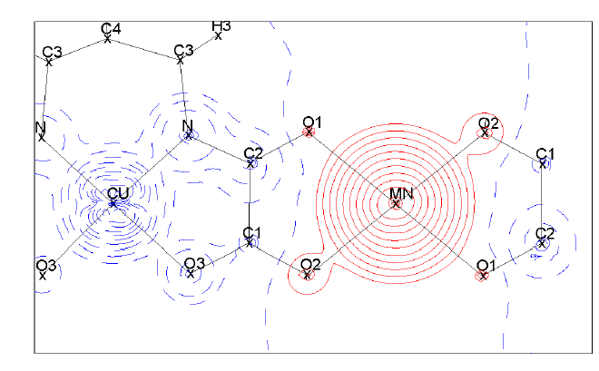
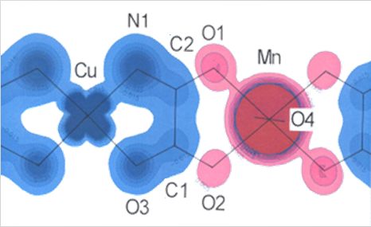
Improved spin density : no a priori fittting
Joint refinement
Log scheme
No a priori assumption on orbital population
In PN only refinement
The d_{x²-y²} shape must be imposed to Cu
Spin density map
Logarithmic contours
Positive red, negative blue
Spin density map
Logarithmic contours
Positive red, negative blue
R_{w}(R) G.o.F N_{obs} N_{par}
0.024 1.93 228 13
R_{w}(R) G.o.F N_{obs}^{NP} N_{par}^{NP}
0.024 1.95 228 37
32
Notes:
We can also compare the previous spin density at 10 K to the one obtained by our joint refinement
For the Mn atom, the shape observed in the joint refinement is close to the spherical one previously described,
For the Cu atom we also observe 4 lobes directed toward the direction of the neighboring atoms but in the case of the joint refinement no a priori model was imposed
Interestingly we observe the same polarization effects on the organic ligand
Finally, the statistical agreements factors are comparable to those of a single spin density refinement
The conclusion is that the spin spilt model we propose is able to reproduce the spin and charge densities previously observed,
This validate our choice for joint xrays and PND data refinement
32

Slide 33
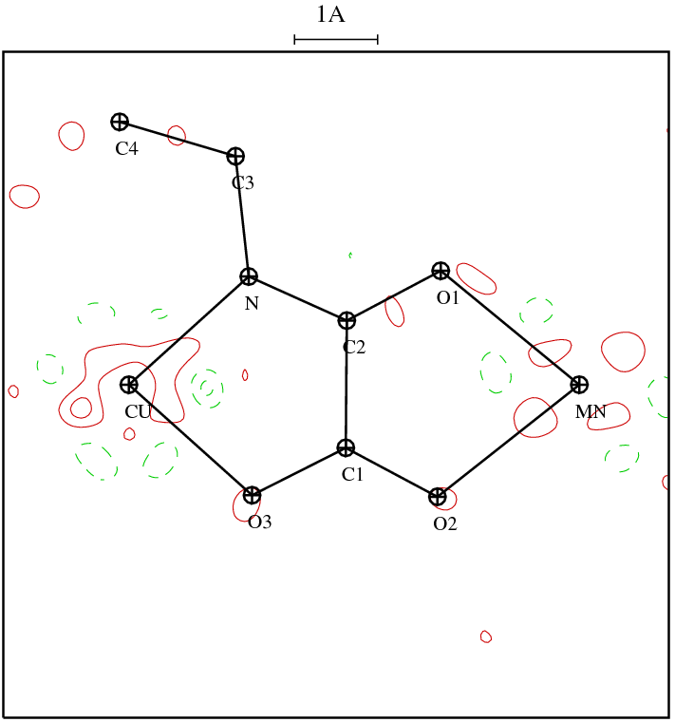
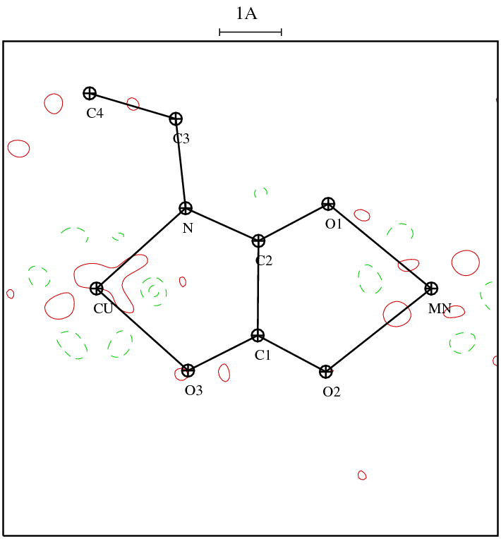
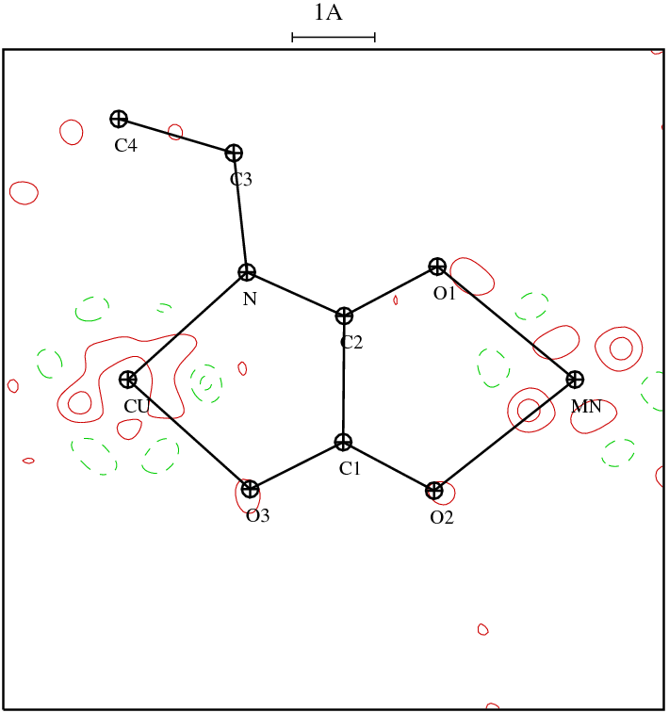
Test compound: different weighting schemes
Unit
Nlog
Log
R_{w}^{X} = 1,63 %
R_{w}^{PN} = 2,34 %
R_{w}^{X} = 1,62 %
R_{w}^{PN} = 2,20 %
R_{w}^{X} = 1,65 %
R_{w}^{PN} = 2,11 %
Residual charge density map, sin(θ)/λ< 0,8Å⁻¹, I>3σ(I), contours 0,1 e.Å⁻³
Deutsch et al. Acta Cryst, A68 (2012) 675-686
33
Notes:
The last test was to compare the three different weighting schemes, here I show you a very brief summary of the comparison, if you want more details I invite you to read this paper, but the conclusion is that the three weighting schemes give close results but NLOG or LOG seems to be a little bit better than UNIT.

Slide 34
conclusions
The Spin split model allows to combine XRD, PND data.
Constraints are crucial to obtain physical results
Reproduce previous results (XRD and PND data only) without a priori.
3 different weighting schemes gives close results.
Let’s test the joint refinement procedure
different kinds of compounds to check its universality.
34
Notes:
In conclusion to this test part we have proven that our spin split model called MollyNX allows to combine XR, neutron and unpolarised neutron diffraction experiments.
Based on these different data set, MollyNX allow to reproduce previous results for XR only or PN only refinements
Constraints are crucial to obtain physical results.
“Weighting schemes give similar results, Log and Nlog weighting seems to be better than UNIT.”
After this test step we would like to apply this joint refinement procedure on a large variety of compounds to evaluate its universality.

Slide 35
A Cu₂ complex
Cu₂(N₃)₂L₂
Ferromagnetic interaction between Cu atoms *
Space group : P2₁/n
* Aronica et al (2007). Chem. Eur. J. 3, 3666–3674 2011
35
Notes:
We present here its structure obtained at 100 K: two Cu atoms are linked by two azido bridges with an inversion centre in the middle
Each copper atom is surrounded by 5 atoms in a pyramidal environment
This molecular magnetic complex present a ferromagnetic interaction between Cu atoms at low temperatures as indicated on this curve

Slide 36
Xray and neutron diffraction data
Experiment | X Rays | Unpolarised neutrons | Polarised neutrons
Number of reflections used | 7208 | 2303 | 212
Temperature (K) | 10 | 30 | 2
Magnetic field applied (T) | - | - | 5
Wavelength (Å) | 0.71073 | 0.832 | 0.84
36

Slide 37
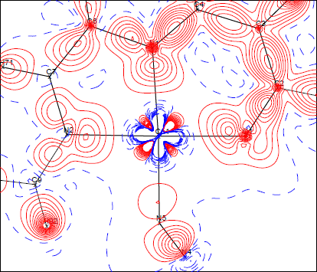
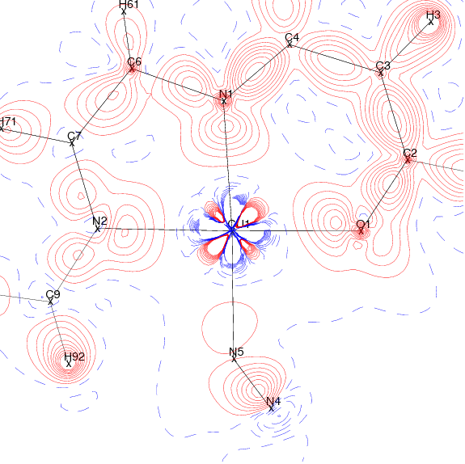
Static deformation charge density
X-rays only
Charge
Joint refinement
(charge and spin) NLog
Static deformation charge density map
Contours 0.1e⁻.Å⁻³ ,
positive red, negative blue
Static deformation charge density map
Contours 0.1e⁻.Å⁻³,
positive red, negative blue
R_{w}(F) G.o.F N_{obs} N_{par}
0.0151 1.08 7208 625
R_{w}(F) G.o.F N_{obs}X N_{par}X
0.0152 1.07 7208 626
37
Notes:
So now I am showing you the results we obtained for this joint refinement. Here I show you the static deformation density maps. The charge density was refined against X-ray data only on the left and as in our joint model we have information about charge and spin we can also plot the charge density obtained with the joint refinement. The charge densities represented here are in both cases almost the same with nitrogen and oxygen lone pairs directed toward copper depletion and electron density on the bond and the statistical agreement factors are also the same

Slide 38
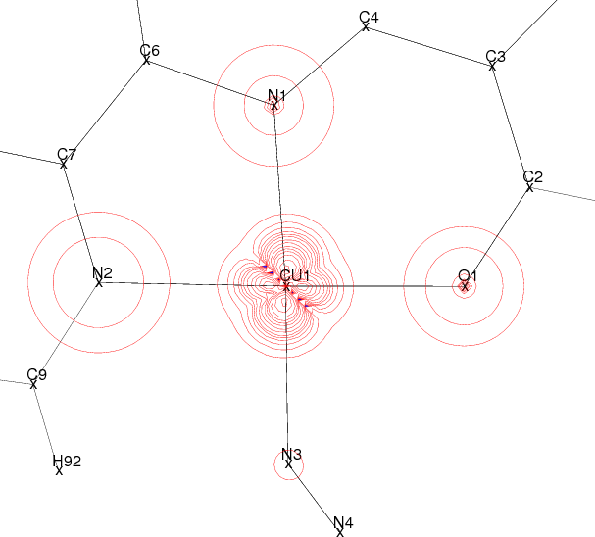
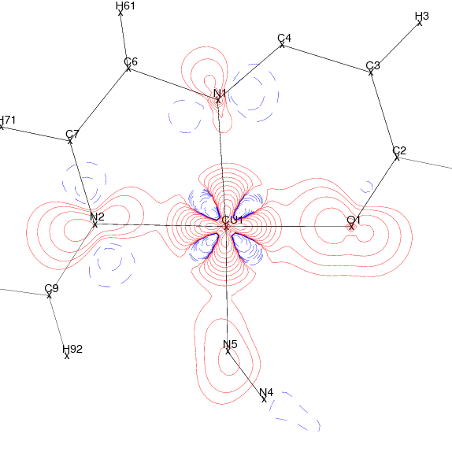
Static spin density
PN only (2K)
Joint refinement NLog
Spin density map
Positive red, negative blue
Spin density map
Positive red, negative blue
R_{w}|1-R| G.o.F N_{obs} N_{par}
0.079 1.30 212 13
R_{w}|1-R| G.o.F N_{obs}NP N_{par}Np
0.071 1.39 212 69
Lecomte et al (2011) ACA Trans. http://www.amercrystalassn.org/2011-transactions-toc symposium in Honor of Prof P Coppens
Deutsch et Al IUCrJ may 2014
Notes:
For the spin the refinement against polarised neutrons data only is on the left and as I previously said: in our model we have information about charge and spin so we can plot the spin. It converges to this solution thanks to X-ray data and constraints on multipoles. The two maps present several differences: spin is more contracted for PN only. These differences can be explained because we do not refine exactly the same thing an orbitale model on the left and a multipolar model for joint refinement we refine also Kappa and Kappa prime for all atoms in joint refinement
The statistical agreements factors are also almost the same.

Slide 39
Something new brought by the joint refinement :
spin up electrons are more contracted than the down ones :
a proof of old theoretical predictions ( 1985)
κ_{Cu}↑ = 0.998(1)
κ_{Cu}↓ = 0.943(1)
Experiment : Δκ/κ = 5%
Theory* : Δκ/κ ~ 1 to 2%
The spin down electrons are more expanded than the spin up
*Becker, P. & Coppens, P. (1985). Acta Cryst. A 41, 177–182
Watson, R. E. & Freeman, A. J. Phys. Rev., American Physical Society, 1960, 120, 1125-1134
39
Notes:
But for this compound we were able to refine separately for the first time Kappa up and kappa down for the copper atom and we can see that as predicted by theory electron cloud with spin up is more contracted than e with spin down a 5% difference while the theory predict a difference of 1 to 2%.

Slide 40
First mapping of the spin resolved density …
Charge ρ↑+ρ↓
Spin ρ↑-ρ↓
Charge density Contours 0.1 e.A⁻³
Spin Density Contours ± 0.01*2^{n} μ_{B}.A⁻³
ρ↑ and ρ↓
(ρ↑+ρ↓) + (ρ↑-ρ↓) = 2* ρ↑ (ρ↑+ρ↓) - (ρ↑-ρ↓) = 2* ρ ↓
40
Notes:
So the joint refinement gives us access to charge density and spin density to rho up +rho down and to rho up minus rho down. But these two maps are already available with the two separated study, with the joint refinement we can go further and plot rho up and rho down separately.

Slide 41
First spin resolved experimental electron density maps
Cu spin up ρ↑
Valence density
Cu Valence spin down ρ↓
density
Contours ± 0.01*2^{n} μ_{B}.A⁻³(with n=0 to 12)
The spin down electrons are more expanded than the spin up
41
Notes:
We are able for the first time to see experimentally rho up and rho down separately. What these figures are showing us is very interesting. We can see that the spin up valence density is almost spherical while All the deformation seems to be carried by rho down. To be more quantitative we can project these two densities on the d-orbital of the Copper atom

Slide 42
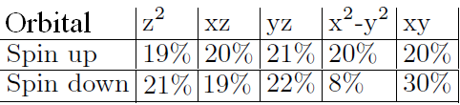
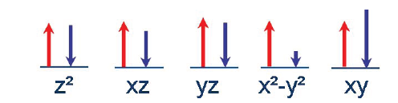
Spin up and spin down d like orbitals populations…
Projection of ρ↑ and ρ↓ on the d-orbital of the Cu atom
42
Notes:
By doing the calculation of the spin up and spin down occupancy for each d-orbital, we can see that there is one electron with spin up in each orbital while there is no electron with spin down in the dx²-y² orbital.
This scheme is a representation of the table we can see a hole in the dx²-y² orbital

Slide 43
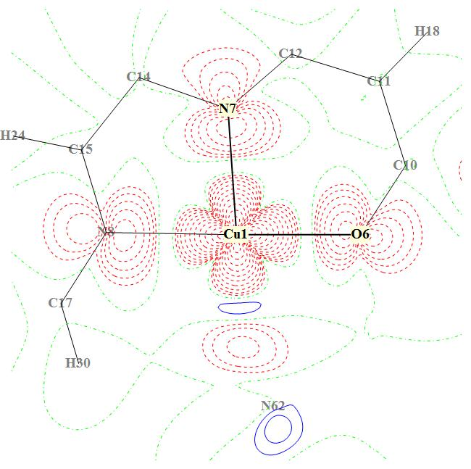
Comparaisons with density functional theory
Spin density
-DFT , B3LYP (unrestricted)
-Base STO 6-31G (d,p)
Joint refinement (NLog)
contours of ±0.01*2^{n} μ_{B}Å⁻³(n= 0 to 12)
positive: red, negative: dashed blue
43
Notes:
When we directly compare theoretical calculations to our joint refinement model the similarities are obvious
The main differences are observed on the surrounding atoms

Slide 44
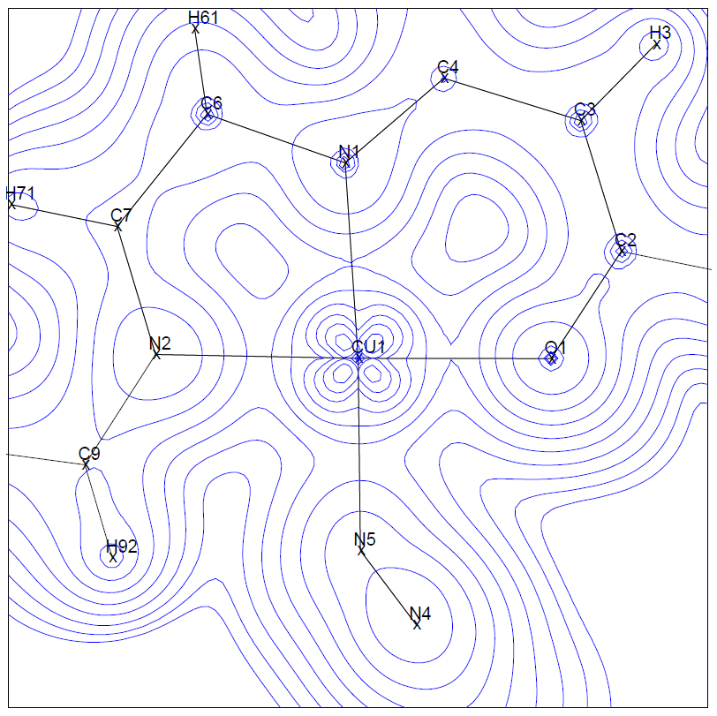
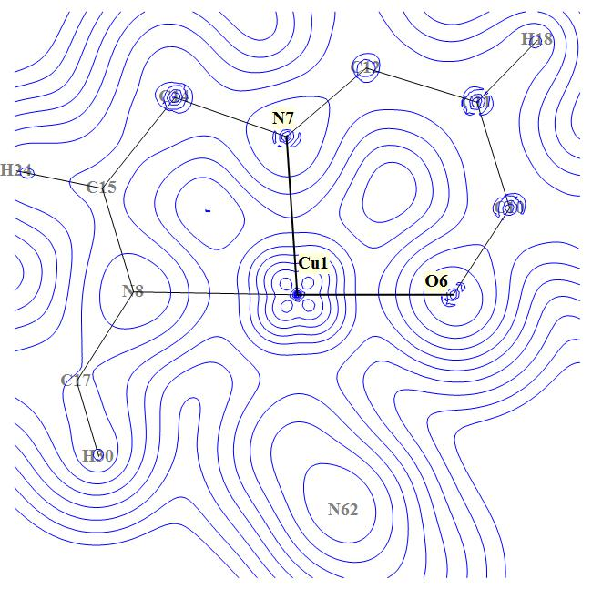
Excellent agreement between experiment and DFT
Experimental valence
spin down (ρ↓)
Theoretical valence density spin down (ρ↓)
Contours ± 0.01*2^{n} μ_{B}Å⁻³(with n=0 to 12)
44
Notes:
These quantities are also accessible in theoretical calculations
The both maps presented on this picture represent spin up and spin down populations

Slide 45
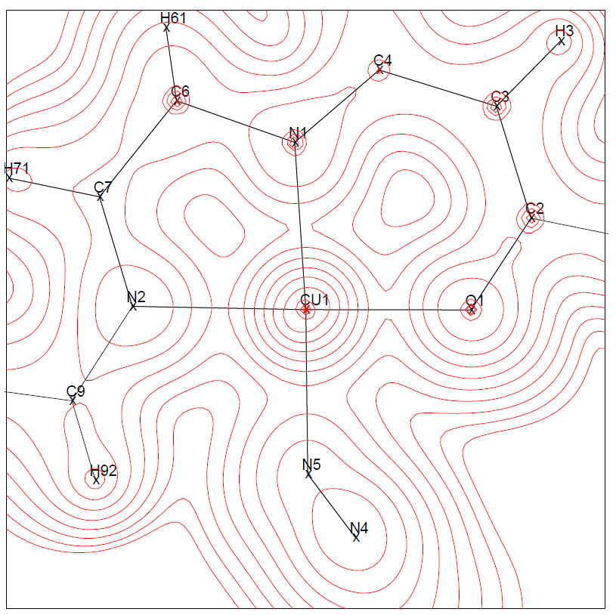
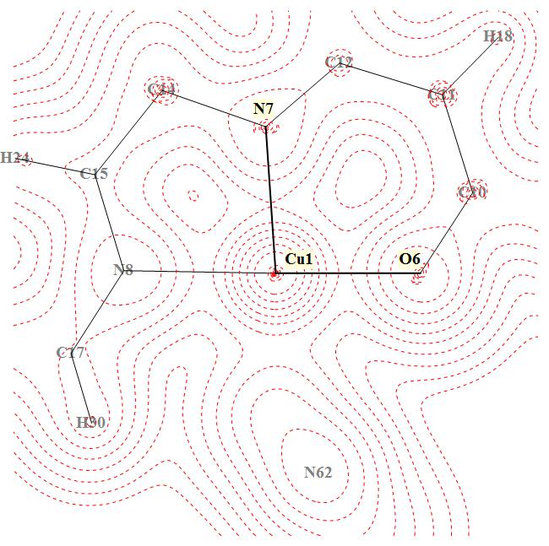
Excellent agreement between experiment and DFT
Experimental Valence density
spin up (ρ↑)
Theoretical valence density spin up (ρ↑)
Contours ± 0.01*2^{n} μ_{B}Å⁻³(with n=0 to 12)
45
Notes:
These quantities are also accessible in theoretical calculations
The both maps presented on this picture represent spin up and spin down populations

Slide 46
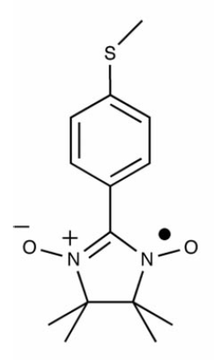
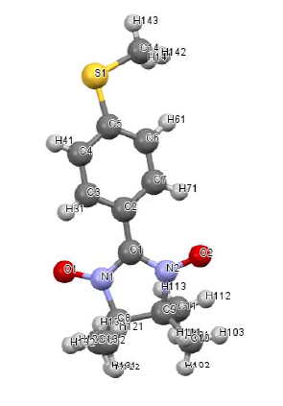
Last example: the Nit(Sme)ph radical :preliminary results .
CH3
Figure: a mesomeric representation of the radical Nit(SMe)Ph (S. Pillet et al, (2000))
PhD thesis of Bolivar Voufack starts october 2014

Slide 47
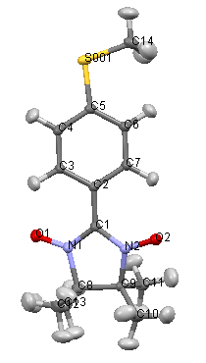
X /PN joint refinement
Types of experimental data | X-rays / polarized neutrons
Number of data XRD/PND | 8800 / 352
Range of resolution XRD /PND | 0<Sin(θ)/λ<0.9 / 0<Sin(θ)/λ<0.5
reflections XRD/PND | I>3σ(I) / I>0.0σ(I)
Number of refined parameters | 305
Weigthing scheme | LOG
Refined parameters | xyz Uij Sc_{X}, Sc_{NP} ,Pv, κ, Plm, κ’
HO refinement ; then charge density refinemeent
With H at Neutron position + Shade for Uij
Then joint refinement

Slide 48
Statistics and Kappa
R(%) |  | wR(%) |  | GoF
XRD | PND | XRD | PND | XRD | PND
1.95 | 7.75 | 2.60 | 6.63 | 0.909 | 1.714
: Statistical agreement factors at the end of joint refinement
atom | κ up | κ down | κ’
O | 1.003(2) | 0.957(2) | 0.80(2)
N | 1.014(2) | 0.972(2) | 0.80(4)
Expansion-contraction parameters of O and N at the end of joint refinement
Spin down more expanded than spin up
atom | κ | κ’
S | 0.968(3) | 1.00(3)
C | 0.975(1) | 0.897(6)
Expansion-contraction parameters of S and C at the end of joint refinement

Slide 49
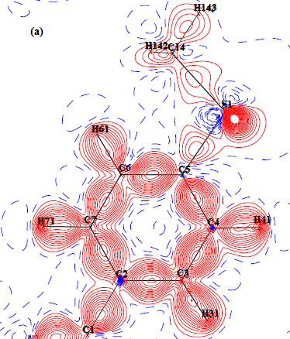
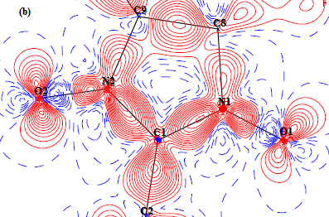
static deformation charge densities
(a) phenyl plane and (b) nitronyl nitroxide mean plane
Contours at interval 0.05 e/A³
No similarity applied to the NO groups

Slide 50
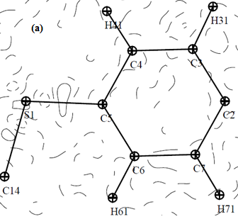
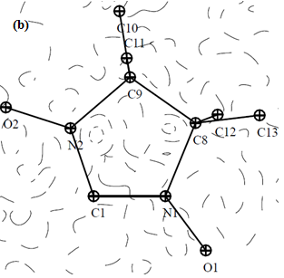
residual charge densities maps in (a) phenyl plane and (b) nitronyl nitroxide mean plane
All information has been modelled

Slide 51


spin resolved deformation charge densities.
spin up
spin down
. Contours at interval of ±0.025 eÅ⁻³
No difference between up and down then most magnetic electrons are elsewhere

Slide 52


spin resolved deformation charge densities ) in C1—O1—O2 plane .
Spin up spin down
The main difference is at the NO-C -NO group sites as expected

Slide 53
Perspectives
Polarized neutrons and XMD to separate spin and orbital contribution
MollynX will include XMD
MollynX is being incorporated in our general Mopro software
A second model based on wave functions fitting to include Compton and magnetic Compton scattering data by refining the off-diagonal part of 1e-RDM is under development.
Deutsch et al. Acta Cryst, A68 (2012) 675-686
Deutsch et al IUCrJ may 2014
53

Slide 54

Thank you for your attention
Any questions???

Slide 55


Spin interactions: (a) Intramolecular and (b) intermolecular spin interactions.
Contours at 0.01*2^n µ_{B} .Å⁻³

Slide 56


Joint refinements ? A long story !
Same crystal, same temperature
⇒ Identical thermal parameters,
Different structural parameters
Same weights
Notes:
More than 40 years before, Duckworth and co-workers proposed a joint refinement of neutron and Xray diffraction data.
Both experiment were done on the same crystal at the same temperature, which is not common.
The authors could then assume that the temperature parameters are the same for both sets but positional parameters could be different.
As they assume also the same weight for both data sets, they propose this least-square matrix to refine.

Slide 57


Joint refinements ? A long story !
⇒ Temperature scale factor (linear)
⇒ Relatives weight : 2117 (X)/ 3164 (N)
ϕ : Fractional dependence
f, b: Scattering factors
Notes:
More recently, Coppens and co-workers resumed this approach with data collected at different temperatures.
If they include a temperature scale factor, as the number of collected reflections is almost comparable, they do not include a specific weighting between the experiments.

Slide 58
Comparison between experimental results from joint refinement and DFT calculations ( Pontillon 1999).
atom | Pv↑ - Pv↓ | SPIN FROM DFT (Y. Pontillon et al. (1999)) | atom
S | / | -0.004 | S
O1 | 0.22(1) | 0.304 | O2
O2 | 0.27(1) | 0.308 | O1
N1 | 0.30(1) | 0.221 | N2
N2 | 0.31(1) | 0.225 | N1
C1 | -0.13(2) | -0.063 | C1
C2 | 0.03(2) | 0.005 | C2
C3 | -0.01(2) | -0.010 | C7
C4 | 0.05(2) | 0.002 | C6
C5 | -0.03(2) | -0.007 | C5
C6 | 0.02(2) | 0.002 | C4
C7 | -0.03(3) | -0.008 | C3
C8 | / | -0.006 | C9
C9 | / | -0.005 | C8
C10 | / | 0.017 | C10
atom | Pv↑ - Pv↓ | SPIN FROM DFT (Y. Pontillon et al. (1999))
H 31 | 0.02(1) | /
H41, H61, H71 | / | /
H of C10, C11, C12, C13 | / | /
H 141, H142 | / | /
H143 | -0.02(1) | /
Discrepancy between experiment and DFT
On the 2 NO groups
Very few experimental spin density on
H31 and H 143

Slide 59







Acknowledgements
Mohamed Souhassou
Nicolas Claiser
Claude Lecomte
Jean-Michel Gillet
Béatrice Gillon
Sébastien Pillet
Dominique Luneau
Pierre Becker
59

Slide 60


Charge and spin densities : Combining Xray and neutrons
X-ray Diffraction
d orbitals
Polarized Neutrons Diffraction
Spin density
Using X ray , neutron diffraction to model electronic structure and magnetic properties of crystals
Notes:
Actuellement, ces différentes mesures sont exploitées de façon séparée.
* La densité électronique dérivée de la diffraction X est limitée aux termes diagonaux de la matrice densité sans distinction de spin,
les neutrons polarisés apportent une information complémentaire de spin sur ces mêmes termes diagonaux.
tandis que dans la diffusion Compton, on mesure la projection de la densité de moment sur une direction donnée, et le profil obtenu est lié aux termes non-diagonaux de la matrice densité par la relation XXX
La méthodologie que l’on va appliquer pour modéliser expérimentalement la matrice densité est la suivante :

Slide 61


How to get all ground state properties of a given material
Diagonal part of 1e-Reduced Density Matrix
Charge density
Spin Density
Off-diagonal part of 1e-RDM
Momentum density
61
Notes:
So we want to use the 1e-RDM because it has several advantages: it contains all the available information at the 1 electron scale.
For example the diagonal part of the matrix contains the charge and spin densities, while the off-diagonal elements are linked to the momentum density, via the Compton profiles

Slide 62
basic diffraction equations
Laboratory or Synchrotron
X-ray
T as low as possible
2d sin (θ) = λ
Bragg law
d = 1/|H|
θ
Interference Fonction
structure factor
f (H) atomic scattering factor = FT

Slide 63
Scattering Factor :
Fourier transform of the static electron density
Valence electrons
low resolution
Core Electrons
High resolution
Scattering Factors normalized to one electron

Slide 64
Crystal structure determination: X, Y, Z, U^{ij}
^{IAM Independant Atom Model}
IAM
promolecule
free neutral atoms : interatomic
interactions are neglected

Slide 65
Example : Hydrogen and Deuterium
Hydrogen S= 1/2 w₊ = (I+1)/2(I+1) =3/4 w₋ = I/(2I+1 ) = ¼
b= w₊b₊ + w₋ b₋ = 3/4 * 1.085 + 1/4 *(-4.750 ) = -0.374 cm⁻¹²
Deuterium S=1 b = 0.667 cm⁻¹² = 6.67 Fermi ( fm)
H incoherent scattering σ _{incoh} = 80.3 barns ( 10⁻²⁴ cm²)
D incoherent scattering σ _{incoh} = 2.05 barns
Therefore
1° Deuteration is important to reduce large H incoherent scattering associated to the resulting strong background
2° Partial deuteration may vanish the H (D) signal because of the opposite signs of the b factor

Slide 66
The intensity of a magnetic Bragg reflection depends on the relative orientations of magnetic moment m_{j} and scattering vector H = [hkl]*
⇒ α = angle (m_{j}, H).
The magnetic scattering amplitude
b_{Mj}(H) = (e²γ/2m_{e}c²)⋅f_{Mj}(H)⋅σ⋅m_{⊥j}(H)
with m_{⊥j}(H) = sinα⋅m_{j}.
unpolarized neutron beam λ_{n}
m_{⊥j}(H) = sinα⋅m_{j}
θ
90°-θ
θ
α
m_{j}
λ_{n}
H = [hkl]*
the magnetic structure factor (for collinear order) F_{M}(H) ∝ sinα⋅m_{j}
➔ I_{M}(H) ∝ sin²α
limiting cases:
m_{j}
α = 90°
⇒ sin²α = 1
maximum I_{M}(H)
.
α = 0°
⇒ sin²α = 0
I_{M}(H) = 0 !!!
2θ
2θ
H
H
m_{j}

Slide 67
Comparison of bond lengths comparison between Xray ( D_{x}) and neutron (D_{n} )
C=O C-N C-C
The quantity (D_{X} - D_{N})/((σ_{X}² + σ_{N}²)^{1/2}) plotted for O-X bonds (left), C-N bonds (middle) and C-C bonds (right). D_{N} stands for neutron experiment bond lengths, D_{X} for X-ray bond lengths andσ_{X} andσ_{N} for X-ray and neutron standard deviations. Black and gray colors means D_{X} were taken respectively from conventional and high order X-ray refinement
Conventional and neutron C=O bond lengths dispersion is slightly larger due to lone pair density: slight overestimation of C=O in the X-ray structure, as the oxygen atom position is slightly pulled in the direction of the non-modeled lone pairs.

Slide 68
Ferroelectricity and H bonds
hydrogen-bonded ferroelectrics of the KDP-family X(H,D)₂PO₄ with X = K, Rb, Tl, NH₄, …
It is a special case of strong hydrogen-bond with H/D-disorder
short O – O distance, typically in the range of 2.5 Å
disordered H/D distribution in the crystal structure, which may be interpreted as corresponding to a double-well potential
almost linear O – (H/D)··(H/D) – O arrangement
symmetric H/D-bond according to or 2 symmetry
⇒ hydrogen-bonded ferroelectrics of the KDP-family X(H,D)₂PO₄ with X = K, Rb, Tl, NH₄, …

Slide 69
High resolution neutron structure of Nicotinamide Adenine Dinucleotide (NAD⁺)
Crystallographic data
Radiation type ; Wavelength (Å) 0.8305(2)
Space group: triclinic P1
Z 1
Unit cell a, b, c (Å) 8.57(1), 8.83(1), 11.19(1)
α, β, γ (°) 109.7(1), 90.6(1), 104.0(1)
Resolution (Å) 0.65 (-13 ≤ h ≤ 13, -13 ≤ k ≤ 13, -17 ≤ l ≤ 1 )
Nb. measured ; unique reflections: 6343 ; 5990
Nb. reflections with Ι /σ_{I} > 3 4988
R_{merge}(I) : 0.056
All reflections:
<Ι /σ_{I}> 12.9
Reflections with Ι >3σ_{I} 78 %
All reflections Ι /σ_{I} > 3
R (F) 0.095 0.062
wR (F) .054 0.050
g.o.f, 1.95 2.00
R_{merge}(I)= [ Σ_{H}Σ_{i}(w_{H,i}(Ι_{H,i} - <Ι _{H}>)² ) / (Σ_{H}Σ_{i} w_{H,i} <Ι_{H,i}>²) ]^{½}
R (F)= [ Σ_{H} ( |F_{obs}(H)| –|F_{calc}(H)| )² / Σ_{H} |F_{obs}(H)| ² ] ^{½}
wR (F)= [ Σ_{H} w(|F_{obs}(H)| –|F_{calc}(H)|)² / Σ_{H} w |F_{obs}(H)|² ]^{½}
g.o.f = [ Σ_{H} w(|F_{obs}(H)|–|F_{calc}(H)|)² / ( N_{obs} – N_{par}) ]^{½}
w_{H,i} = 1/ σ(Ι_{H,i}) ² weighting factor for observation number i of the reflection H.
w= 1/ σ²_{F}, weighting factor of the unique reflection H.
N_{obs} = number of observations used for the refinement, N_{par} = number of refined parameters,
F_{obs} = scaled observed structure factors amplitudes,
F_{calc}= calculated structure factors amplitudes.
B. Guillot et Al , Acta Cryst., 2001, D57, 981-989

